Slide 1

LCU-Net: A novel low cost U-Net for environmental microorganism image segmentation
Jinghua Zhang, Chen Li, Sergey Kosov, Marcin Grzegorzek, Kimiaki Shirahama, Tao Jiang, Changhao Sun, Zihan Li, Hong Li
Presented By
Aditya Chakma - 0421052072

Slide 2
EMs
“Environmental microorganisms (Ems) are very tiny living beings in our surroundings, which are natural decomposers and indicators.”
In industrial countries, industrial pollution has been threatening human lives and health. So, reducing pollution is a must.
EMs can help us reduce pollution by digesting organic waste, So effectively identifying EMs is a work of research in the field of environmental pollution.

Slide 3
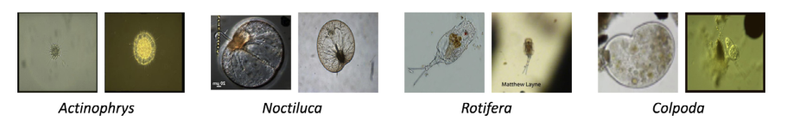
EMs

Slide 4
EMs identification
Chemical method. (Highly accurate. Secondary pollution)
Physical method. (Highly accurate. Expensive equipment)
Molecular biological method. (Highly accurate. Expensive and time consuming)
Morphological method. (Cheap. Experienced and skillful operator identifies by observing shape characteristics).

Slide 5
Previous works
Category | Subcategory
Classical | Threshold based methods Edge-based methods Region-based methods
Machine Learning | Unsupervised Methods Supervised Methods

Slide 6
Previous works
Classical Methods: Otsu thresholding method, canny edge detection method, watershed algorithm
Machine learning base: k-means, MRF, U-Net.

Slide 7
U-Net
Supervised Machine Learning model.
It’s a CNN (Convolutional Neural Network). Initially used for microscopic image segmentation task.
Can be used with very low data by relying on strong data augmentation.
End-to-End structure
Symmetrical architecture.

Slide 8
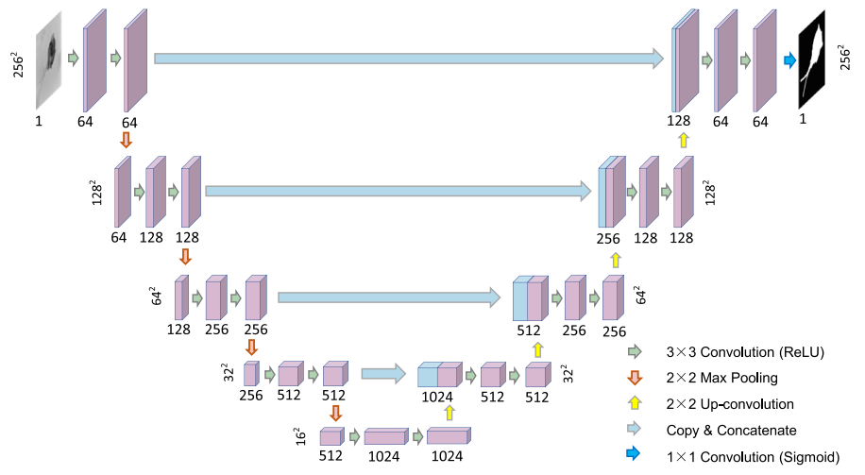
U-Net architecture

Slide 9
Limitations
Limited Adaptability
Single receptive field (3x3)
Relatively high memory

Slide 10
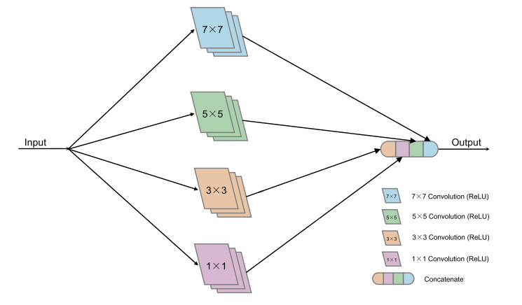
LCU-Net
Problem?
Increases memory cost and computation cost.
Structure of BLOCK-I
Notes:
We replace block of a U-net with BLOCK-I

Slide 11
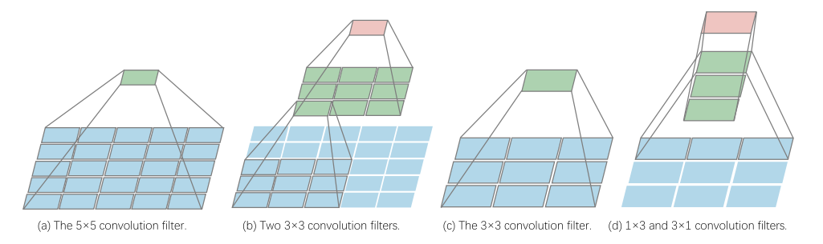
LCU-Net
Notes:
Two 3x3 convolution blocks have same receptive fields as a 5x5 block. And, a 3x1 and 1x3 have the same receptive field as one 3x3 bock. A 5x5 requires 25 parameters. But two 3x3 require 18 parameters.

Slide 12
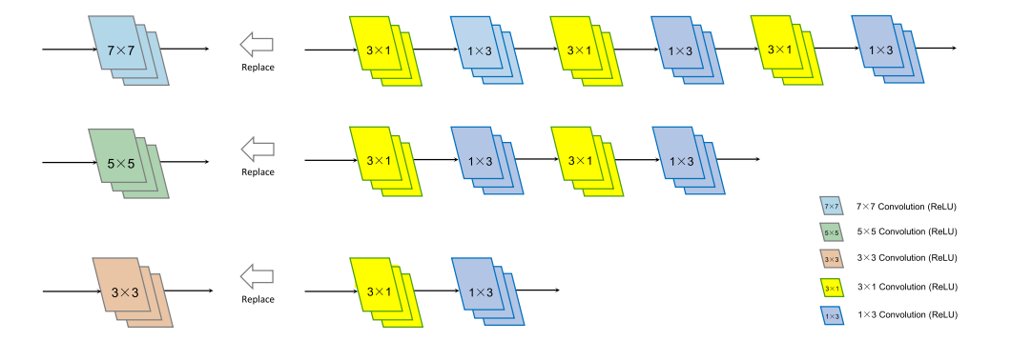
LCU-Net
Notes:
We can replace 7x7 block with 3 3x3 blocks. A 5x5 block can be replaced with 2 3x3 block. And a 3x3 block can be replaced with a 3x1 and 1x3 block.

Slide 13
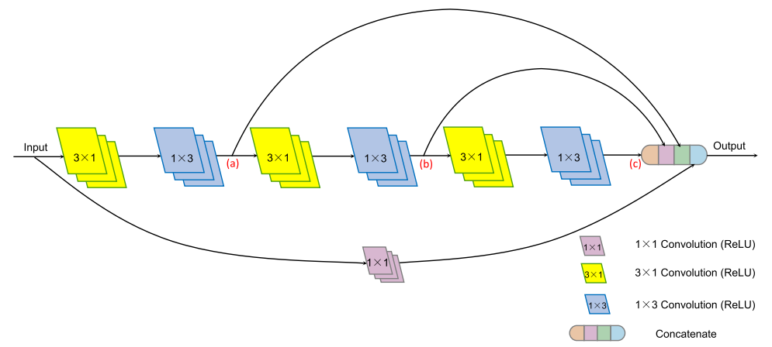
LCU-Net
Structure of BLOCK-II

Slide 14
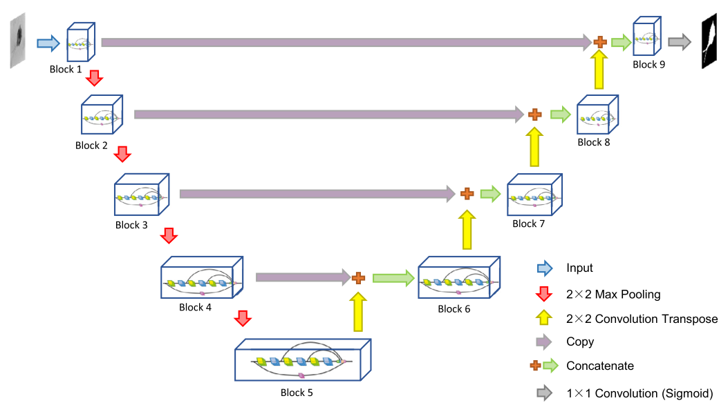
LCU-Net Architecture

Slide 15
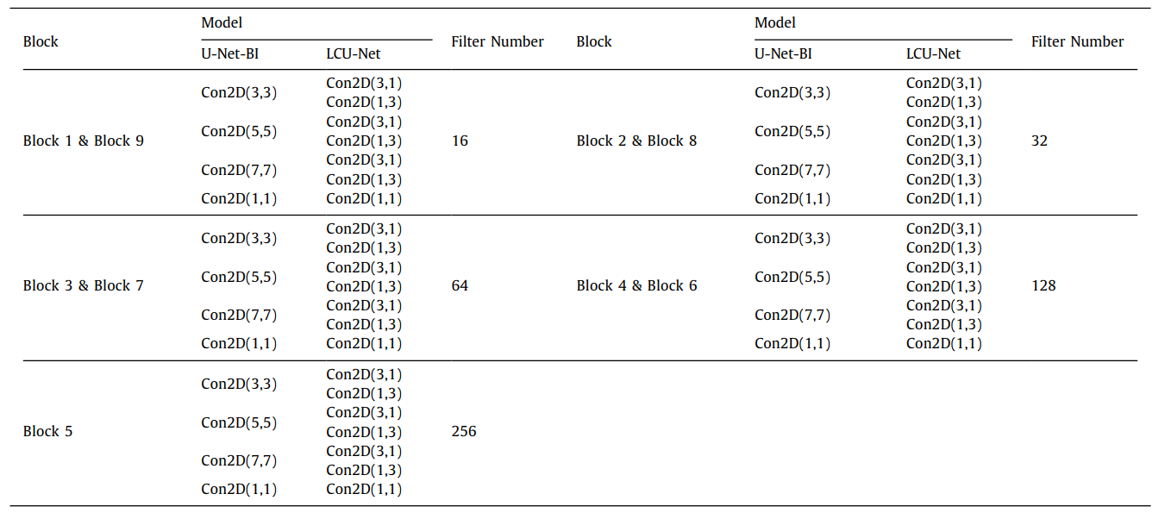
LCU-Net

Slide 16
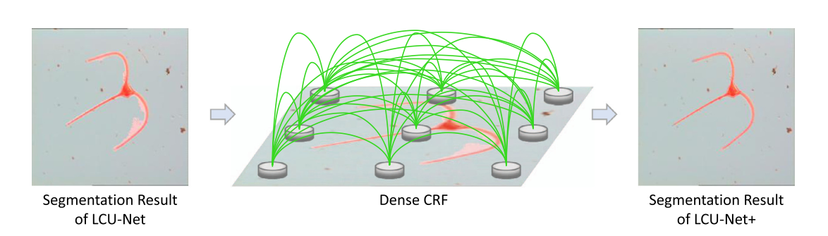
LCU-Net+
In this paper they did some post processing to improve prediction. But we will ignore it, for the sake of simplification of implementation.

Slide 17
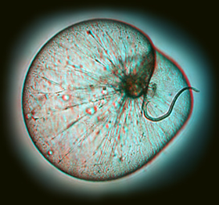
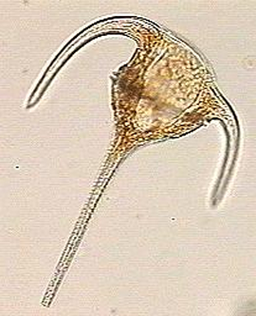
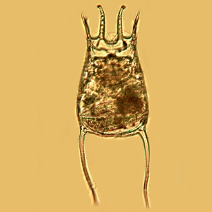
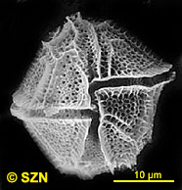
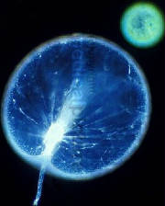
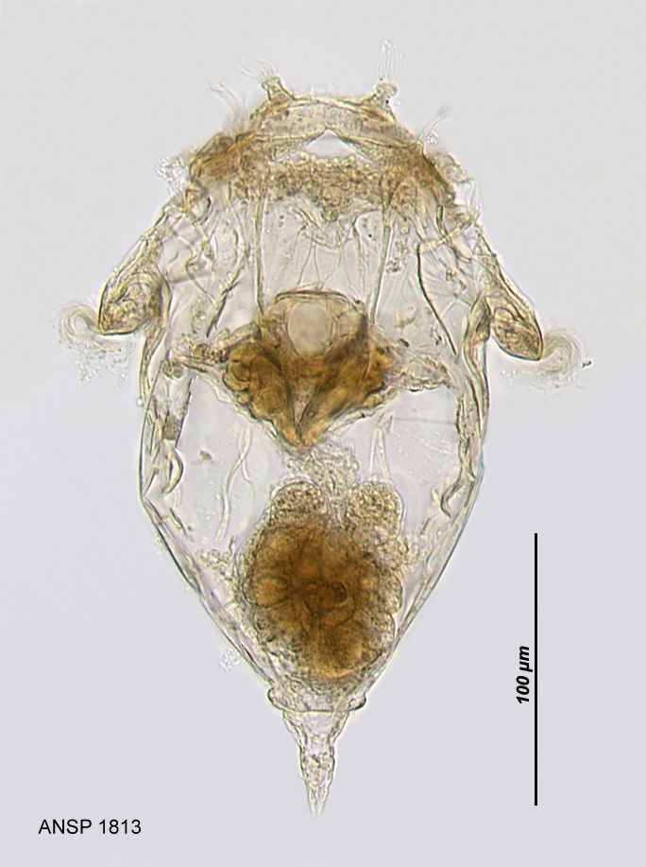
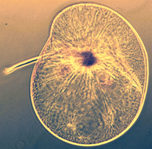
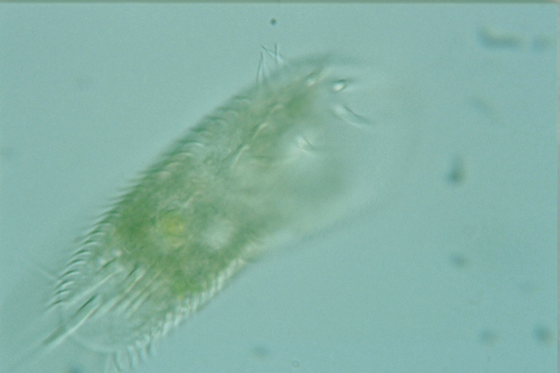
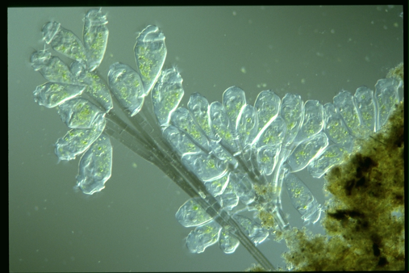
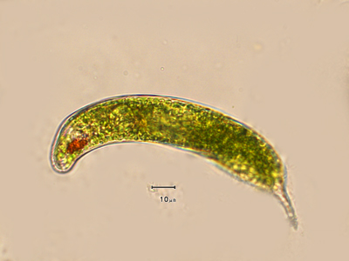
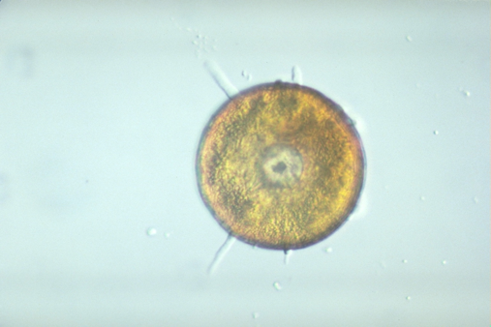
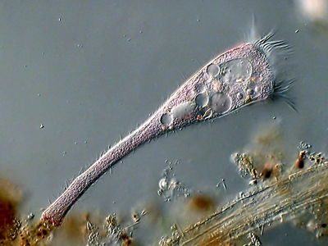
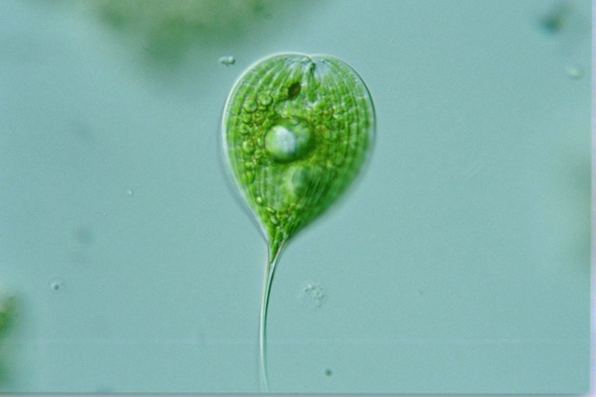
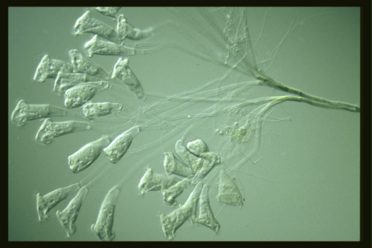
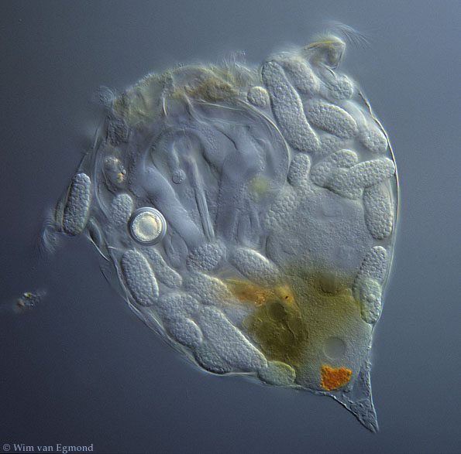
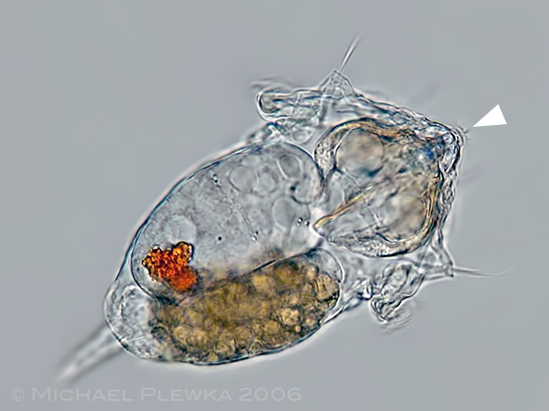
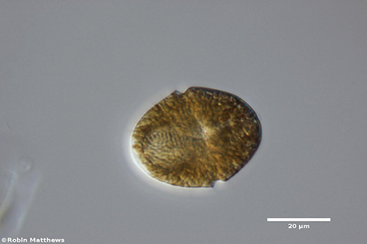
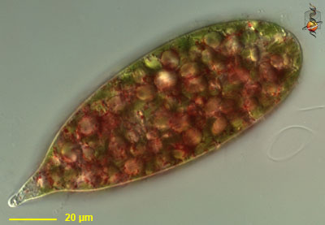
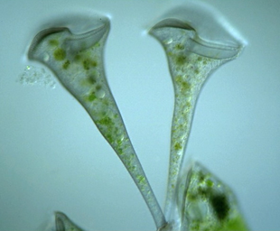
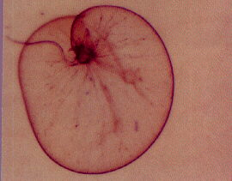
DataSet
EMDS-5
DataSet Split 1:1:2

Slide 18
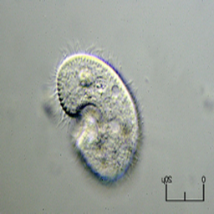
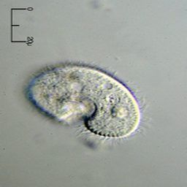
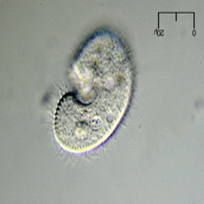
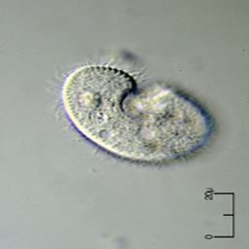
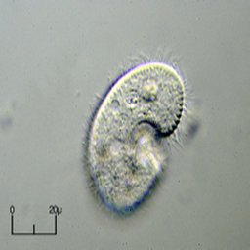
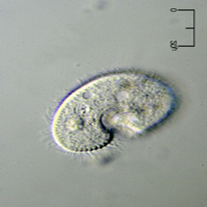
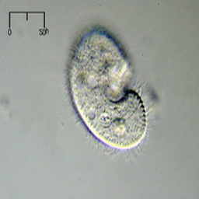
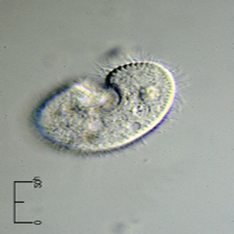
Pre processing
Rotation → 0, 90, 180, 270
Mirror

Slide 19
Hyper parameters
Batch size : 2
Learning rate: 1.5 x 10⁻⁴
Loss function: Pixel wise binary cross entropy loss.
Optimizer: Adaptive moment estimation (Adam)
epochs: 50

Slide 20
Experimental Environment
Jinghua et. al. | Ours
Intel Core i7 8700k 6C12T | Intel Core i7 6700k 4C8T
32 GB 2100Mhz Ram | 32 GB 3200Mhz Ram
Windows 10, Python, Keras | Windows 10, Python, Tensorflow, Tf-Keras
Rtx 2080 8GB | Gtx 1080Ti 11 GB

Slide 21
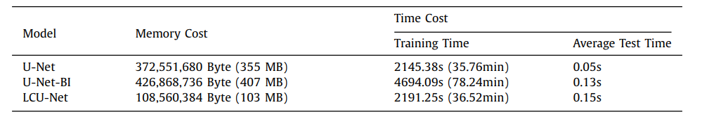
Memory Cost and Time

Slide 22
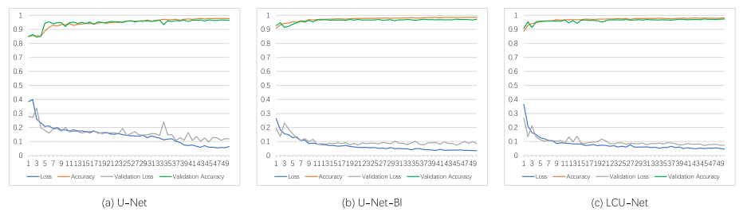
Loss and Accuracy of Different architectures

Slide 23
Evaluation metrices
Dice. Usually used to measure reproducibility. It’s mathematically equivalent to F1 Score. Precision over Recall
Jaccard. Also known as IoU(Intersection over union).
Recall. Ratio of trully positive pixels ratio.
Precision. Portion of the real positive among the pixels, identified as positive by the model.
VOE. (Volume overlap error) complement of Jaccard coefficient.
Accuracy. Ratio of positive and negative pixels by actuals negative and positive.

Slide 24

Evaluation metrices | Terminologies
V_{pred} → Foreground predicted by the model.
V_{GT} → Actual foreground.
Confusion matrix:

Slide 25
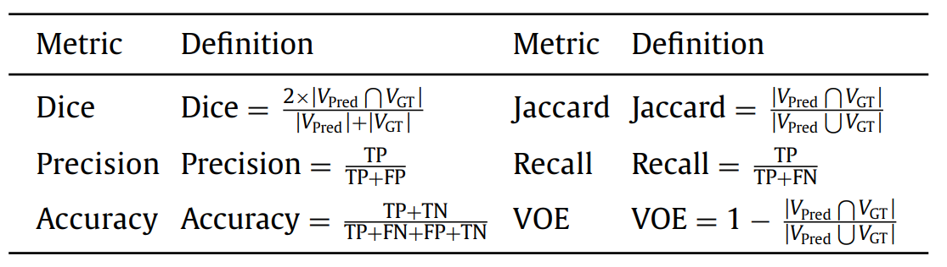
Evaluation metrices

Slide 26
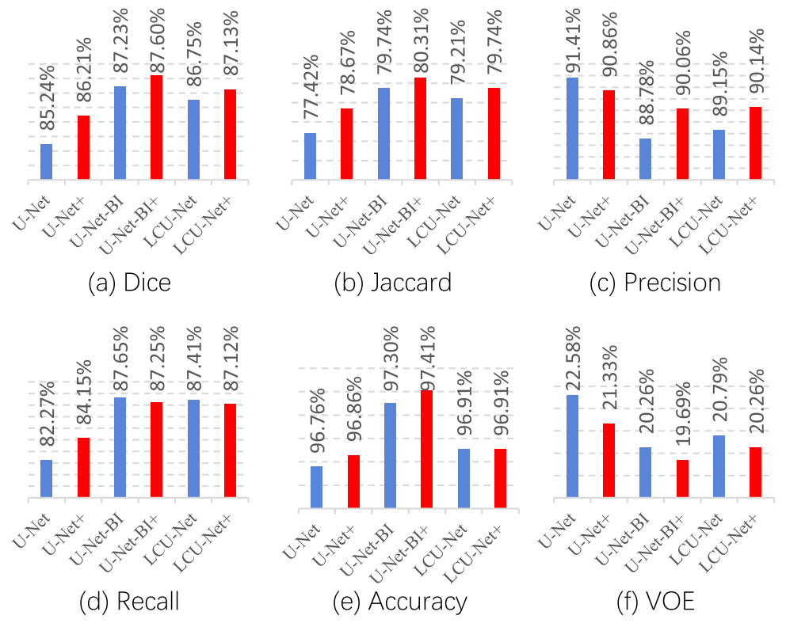
Performance measure

Slide 27
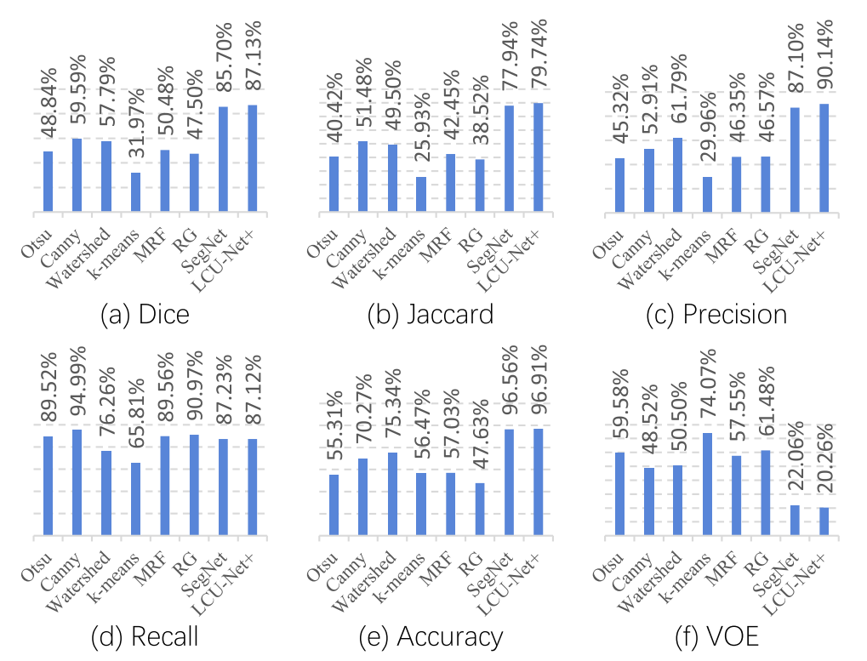
Performance measure

Slide 28
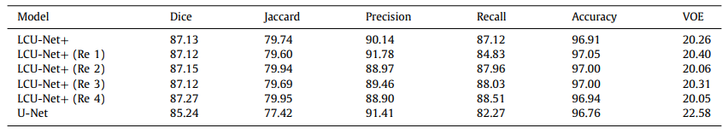
Repeatability Test

Slide 29
Implementation
Now I will demonstrate the implementation.

